Slide 1
Power Bi Project
Ghayasudin Ghayas
Data Science student
QS-Academy
April 22, 2024

Slide 2
Introduction
This project, intended for completion by the end of the Power BI course in QS-Academy Batch 22 student practical work, utilizes a CSV file dataset. The specified Key Performance Indicators (KPIs) are outlined as follows:
Descriptive statistics presented visually, such as box-and-whisker plots or histograms, to illustrate data distribution.
Incorporation of an interactive element, such as an Excel pivot table with slicers, allowing users to explore data subsets.
Exploration of data-driven inquiries through various visualizations (e.g., scatter plots, line graphs), unveiling insights and potentially applying data transformations.
Implementation of analytical storytelling with effective visualizations to convey insights, adhering to best practices for data representation.

Slide 3
Data Visualization Workflow
1- Data Extraction, Transformation, and Loading (ETL):
Extract, transform, and load the data, utilizing both Excel and Power BI.
Clean and reshape the data in preparation for analysis.
Table Relationships:
2- Establish relationships between tables based on matching fields.
Data Analysis and Visualization:
Identify and specify required fields for analysis.
Determine suitable visualization graphs for the analysis.
Creation of Measures and Columns:
Create necessary measures and columns as prerequisites for analysis.

Slide 4
Key KPI Visualization Focus
Visualization of the data is considered based on the following three main KPIs:
Workplace Fatalities in 2012.
Workplace Injuries/Illnesses in 2012.
Workplace Penalties in 2013.

Slide 5
Workplace Fatalities 2012
According to the report:
Total fatalities are 1,132.
The highest (max) fatalities are in Texas, with 536 fatalities.
The average fatalities amount to 92.34.
The lowest (min) fatalities are 8.

Slide 6
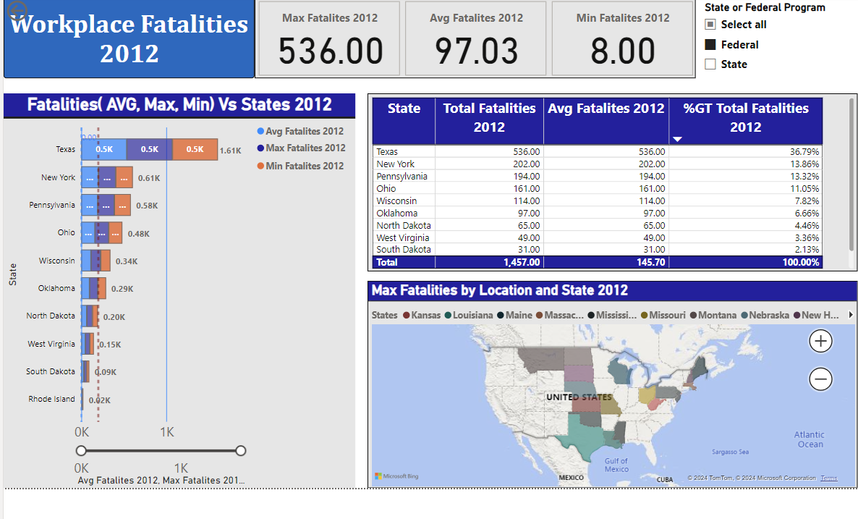
Federal Highest and Lowest Fatality Rates
Texas is in highest fatalities rate and 2nd highest is Network but Rod Island and after that all are in lowest Fatalities Rate.

Slide 7
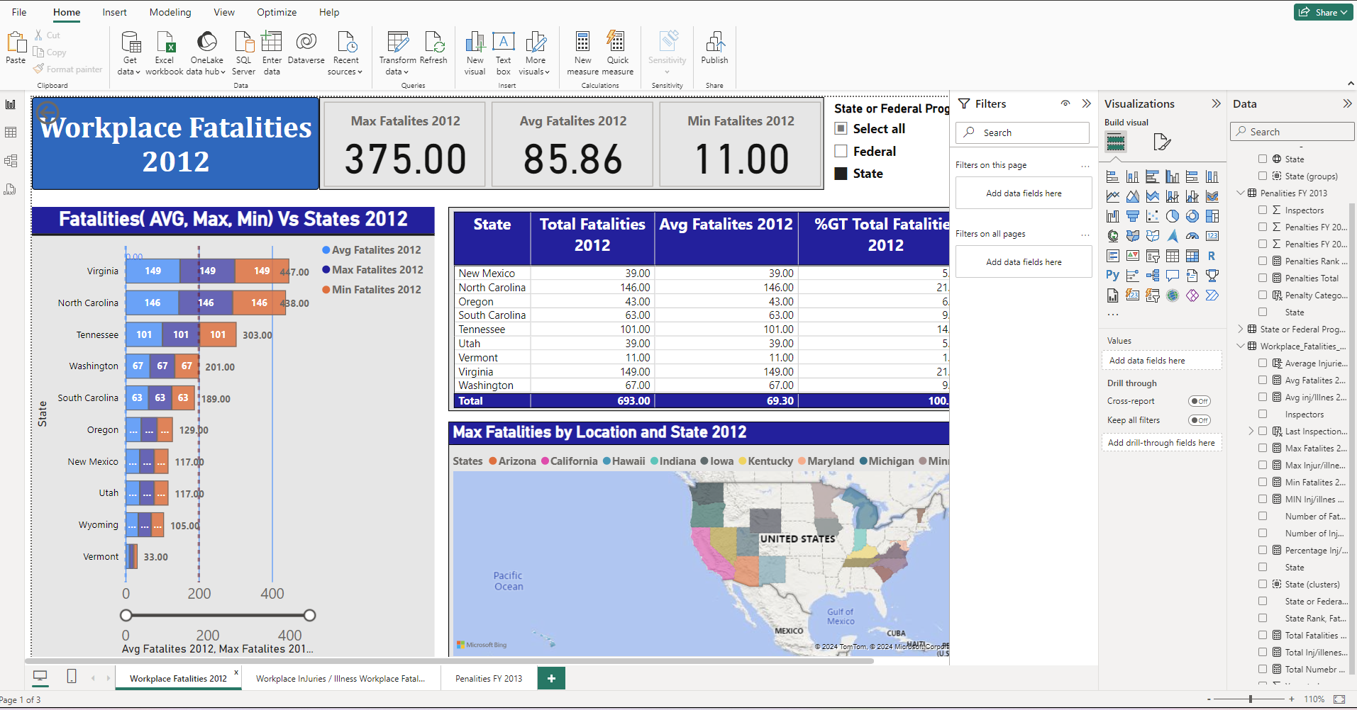
States Highest & Lowest Fatalities Positions Virginia is in highest fatalities rate and 2nd highest is North Carolina but Vermont and after that all are in lowest Fatalities Rate.

Slide 8
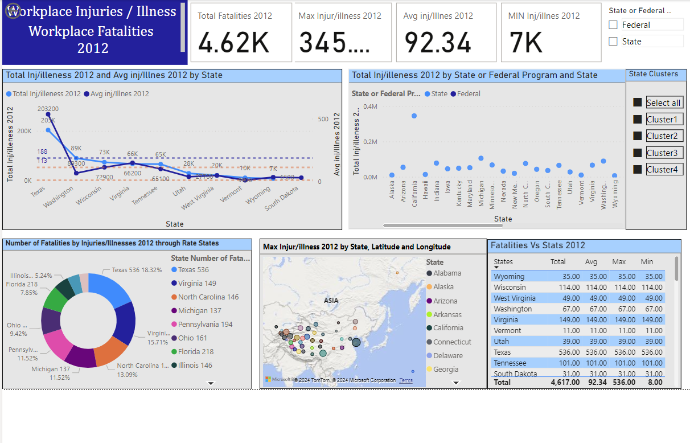
Workplace Injuries / Illness -2021
According to the report , Total Fatalities is 4.62 K and the highest (Max) fatalities is Taxes 345 K
Average Fatalities is 92.34.K and Mini Fatalities is 7K.

Slide 9
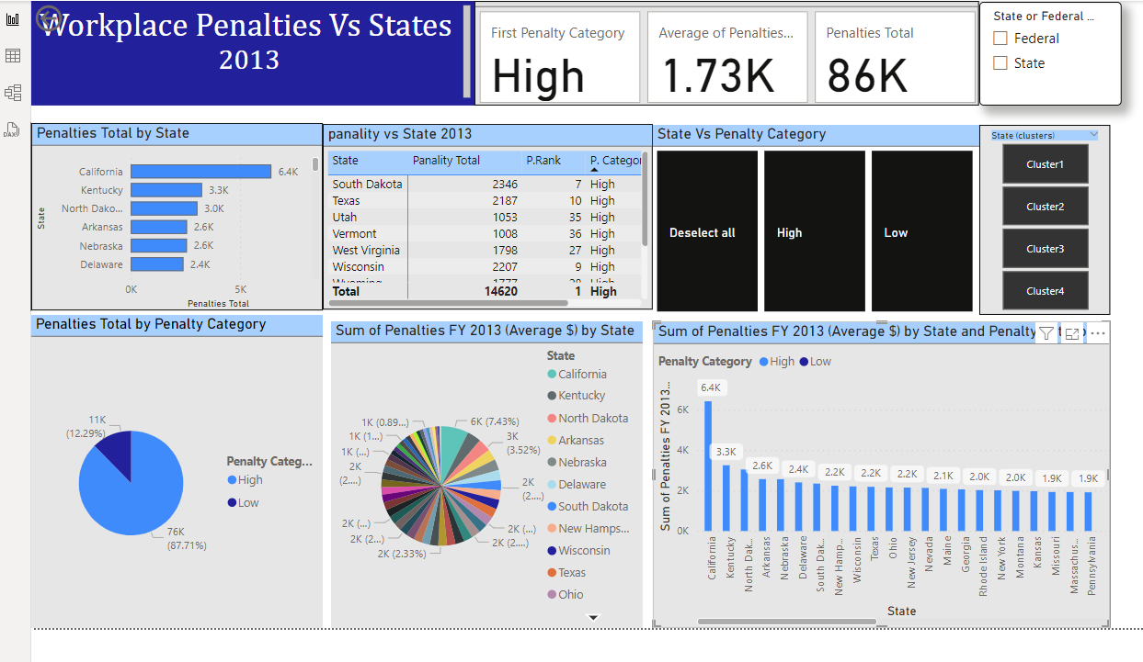
Workplace Penalties Vs States 2013 Based on the report findings , the Total Penalties is 86000 , California is in highest penalties Rate

Slide 10
Conclusion
1- Workplace Fatalities:
In 2012, Texas held the highest position in workplace fatalities, followed by Virginia in 2nd place. Vermont and other states ranked lower.
In terms of federal versus state data, the federal level recorded a higher number of fatalities compared to the state level.
2- Workplace Injuries and Illnesses 2012:
At the federal level, there was a high rate of injuries and illnesses in 2012, while the state level reported lower rates. Once again, Texas ranked highest for injuries at the federal level
3- Penalties vs. State 2012:
California held the highest position in penalties, while Oregon ranked lowest.
Approximately 87.71% of the total data were associated with states in the high penalties category, while 12.29% were in the low penalties category.
End

